Slide 1
G8:E-device For Women Safety
ECM3999 - TECHNICAL ANSWERS FOR REAL WORLD PROBLEMS (TARP)
SLOT: TAA1
FACULTY: PROF. MUTHULAKSHMI S

Slide 2
Group members
AVULA. ROHITHA – 17BLC1007
K. MADHU SWAPNIKA – 17BLC1024
AARTHI G – 17BLC1166
SANTHOSHA – 17BEC1118
GAYATHRI – 17BEC1140
I. SRAVYA – 17BEC1185
NAVYA GAYATHRI – 17BEC1233

Slide 3
SURVEY – Field survey (PROBLEMS IDENTIFIED)
Violence against women
Littering of garbage
Inappropriate drainage systems
Narrow and muddy roads
Infrequent street lights
Improper maintenance of ponds
Far located petroleum bunks
Unhygienic school surroundings

Slide 4
Lack of importance to technology and non-native languages
Afar availability of merchandises
Little or no consideration on timely vaccinations
Far located ATMs and banks
Insufficient hospitals and medical shops
Far located railway stations
Unscrupulous value for nutrition and health of infants and kids
Lack of water treatment

Slide 5

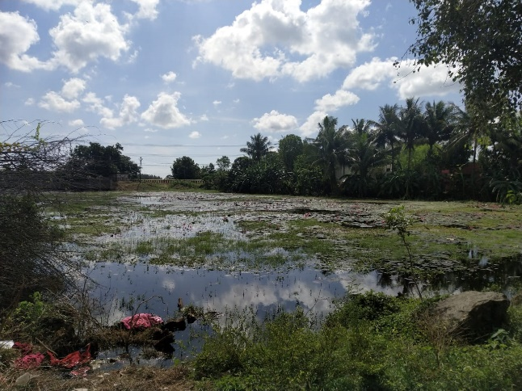
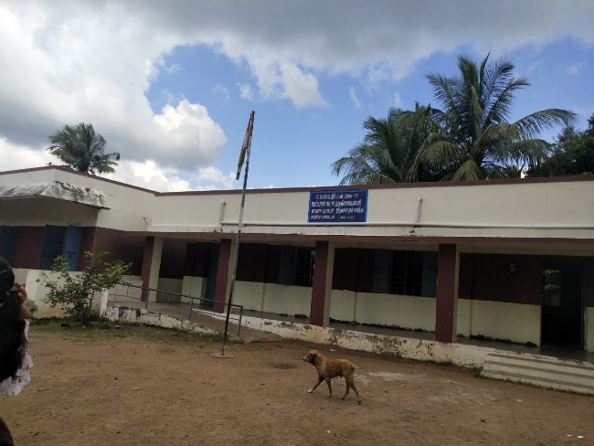
IMAGES

Slide 6


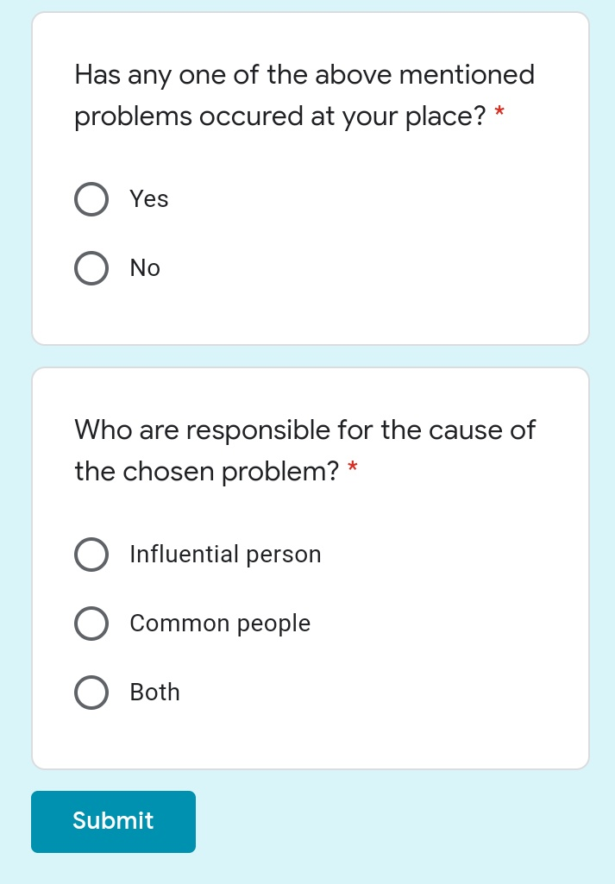
Survey – online survey

Slide 7
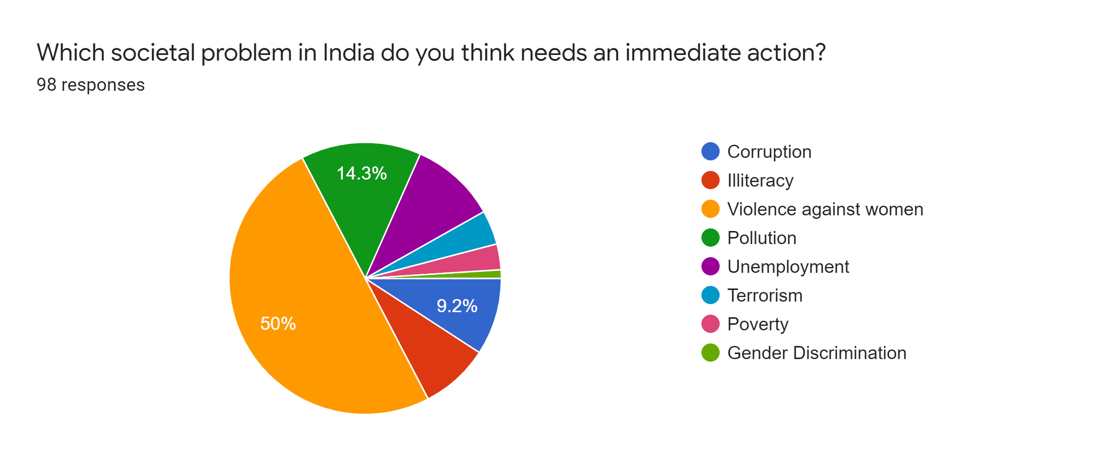
analysis

Slide 8


Slide 9
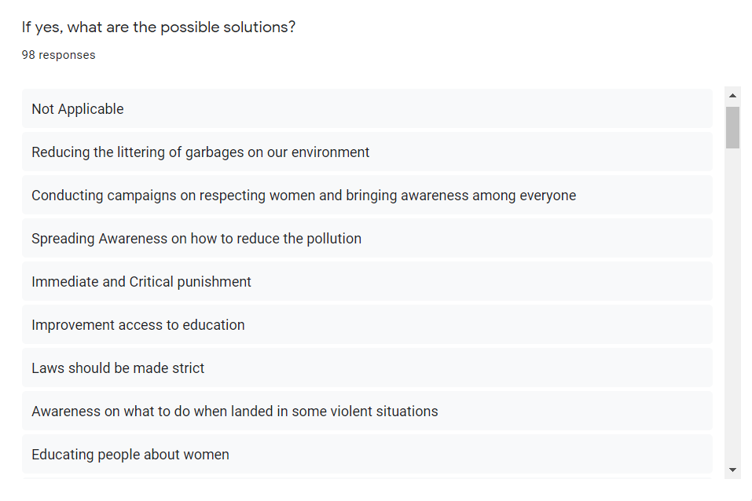

Slide 10


Slide 11
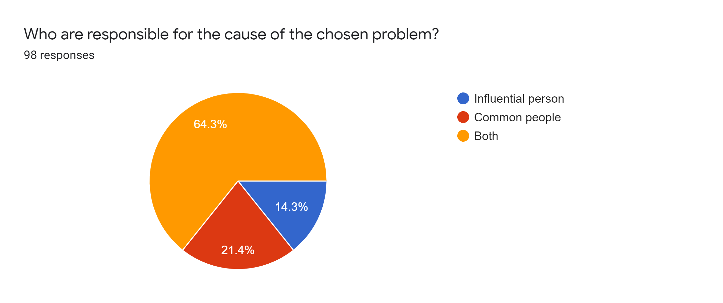

Slide 12
KEY ISSUES TO BE ADDRESSED
1. VIOLENCE AGAINST WOMEN
Violence against women is now widely recognized as an important public health problem, owing to its health consequences. Violence against women among many Indian communities on a regularly basis goes unreported. Violence against women in India refer to physical or sexual violence committed against Indian women, typically by a man.
Most arrested male offenders are for domestic cruelty and assault on women with intent to outrage their modesty. Also, the typical age group of male offenders seems to be 18-35 years which is when they are known to be most aggressive. Both males and females offenders seem to be least for the ages below 18 years and above 60 years.
Common forms of violence against women in India include acts such as domestic abuse, sexual assault, and murder. Most typically, these acts are committed by men as a result of the long-standing gender inequalities present in the country.

Slide 13
Problem statement
India has become one among the worst countries which has the highest record in all forms of sexual exploitation. This is often encountered in places like offices, public transports, streets, educational institutions, etc.
Women and girls are facing a tough time due to the country’s current situation; all their liberty is taken away due to such meaningless acts.
Women are drastically growing equally along with men in almost every field, but are dragged down to situations which degrade their development and courage to succeed.

Slide 14
A few miserable incidents include…
A 23 year old girl who was a rape victim was on her way to court to attend a hearing. But she was burnt alive and swedged to death. This noble soul ran for almost 1km to survive from those painful bruises developing due to the scorching heat caused from the fire and before collapsing she intimated her sorrowful state to police.
A 27 year old veterinary doctor who was returning from hospital found that one of her vehicle tyre was flat. Some people who were nearby approached her for help but this poor soul didn’t know that she was falling into their evil trap. The crew had brutally dragged her to a nearby vacant plot, forced her to consume alcohol, gagged and raped her cruelly with no mercy. She died of suffocation but even after her death she was sexually abused and her body was burnt to leave no traces of their action.

Slide 15
INTRODUCTION
Globally, 7% of women have been sexually assaulted by someone other than their partner. A woman is raped in every 21 minutes in India and every 18 hours in Delhi. About 31% of married women have experienced physical, sexual or emotional violence through their partners. About 99% cases of sexual violence go unreported.
By observing such bad conditions of women in the world, we have planned to design and develop this project to eradicate the fear of brutality from the minds of women in our society.

Slide 16
ABSTRACT
In this project, we intend to create a device to resolve the issue of violence against women we are proposing a women safety system. This device consists of a system that ensures dual alerts in case either a woman is harassed or she thinks that she is in trouble.
This device is to be turned on in advance by a woman in case she is alone or in danger in a remote area.
Once the device is started with the help of the mounted button, the system will immediately send her current location to the authorized personnel number through SMS message as a security measure and also laser, leds and buzzer will get activated so that people who are nearby can realize the threat to be caused. This device will be useful in saving lives as well as preventing atrocities against women.

Slide 17
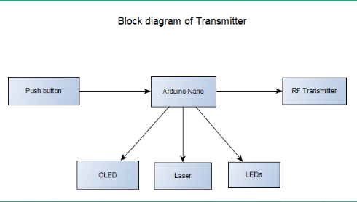
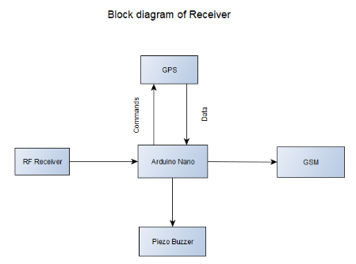
BLOCK DIAGRAM OF SYSTEM DESIGN

Slide 18
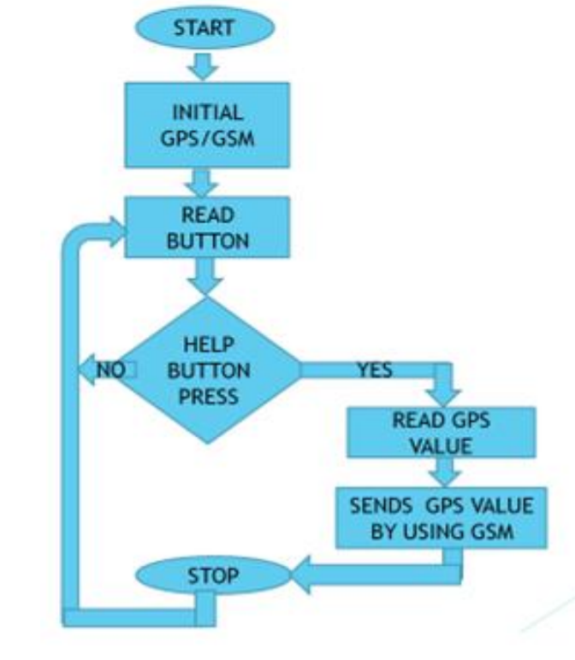
FLOW CHART

Slide 19
Components
ARDUINO NANO
RF MODULE
GSM
GPS
OLED
LASER
PIEZO BUZZER

Slide 20
COMPONENT ANALYSIS
ARDUINO:
Reading data from different hardware devices and controlling the devices.
Can be used for both hardware and software, can be easily accessed and cheaper than the R-pi, can be used for analog sources since it can convert to digital data, needs less power and highly robust.
Why not other:
Needs only digital input, but some microcontrollers require Analog to digital converter device separately.
R-pi is less robust when compared to Arduino and Highly Expensive.
Needs continuous 5v power supply and it is difficult to run it on Batteries

Slide 21
FEATURES:
Operating voltage is 5V, Input voltage (Vin) is 7V to 12V, Power consumption is 19 mA
I/O pins DC Current is 40 mA, Flash memory is 32 KB, SRAM is 2 KB EEPROM is 1 KB CLK
speed is 16 MHz, Weight-7g

Slide 22
RF MODULE:
Why Wireless?
Mobile and avoid the use of long wires at the same time keeping your projects simple.
Less expensive and simple
Lower Frequency than other modules
433MHZ frequency signal doesn't get damaged while transmitting due to rain or moist in air
Maximum range of 3 meters
Example, it you have a temperature sensor that needs to transmit data to a logger every few minutes, then 433MHZ module will probably do

Slide 23
Why not Other:
As 2.4GHZ is the resonant frequency of the water molecule, signal can
get damaged while transmitting over a long distance
Larger range
NFC has a maximum range upto 4 cms but there is no secure
communication,
Features:
RF Module 433MHz

Slide 24
Receiver Specifications:
Supply Voltage: 5V.
Current usage: 5.5mA maximum)
Frequency: 433.92MHZ
Modulation: ASK
Sensitivity: 100dBm
Transmitter Specifications:
Supply Voltage: 3-12V
Current usage: 40mA (maximum)
Frequency: 433.92MHZ
Modulation: ASK

Slide 25
OLED:
Self emitting light source and do not need a separate external light source in order to display an image. Gives even luminance from any viewing angle, Fast response time, Small size form factors, Flexibility in interfacing with Arduino and also Power-efficient.
Why not Other:
OLED screen have high brightness and contrast than CRT and LCD.
Needs a separate external light source in order to display an image.
In LCD, brightness and contrast depends on potentiometer which needs to be
monitored every single time.
Thick and Heavier than OLED and Longer Response time

Slide 26
FEATURES:
Embedded Driver/Controller Display size: 0.96"
Resolution ratio:128 x 64
Interface modes: 12C/IIC
working voltage: 3.3V
Control Chip: SSD1306
Pixel Color: Blue
Driving voltage: 3.3 to 5V
Dimensions: (2.75x2.75x1.1) cm
Weight: 7gm

Slide 27
LASER:
It has a high-Quality level also Cost is economical, small dimensions also works under low driving voltage and low power consumption, also have less laser power about 5mW Brighter.
Why not Other:
IR laser is extremely dangerous because it is invisible to the human eye, can cause blindness when it passes through anterior structures of the eye and reach the retina
Having more laser power can cause damage to the other person.
High voltage - High power Consumption
Expensive

Slide 28
FEATURES:
650nm 6mm 5mW Laser Diode
Output Power: 5m W
Working Voltage: 5V DC
Working temperature: -10 °C - +40°C
Housing material: Copper
Working life: more than 2000 hours
Spot mode: Dot Facula (continuous output)
Laser wavelength: 650nm red-colored.
Operating current: <40mA
Power lead length: 120mm

Slide 29
GSM MODULE:
A GSM module is a chip or circuit that will be used to establish communication between a mobile device or a computing machine and a GSM network system.
This module consists of a GSM module powered by a power supply circuit and communication interfaces. A GSM modem can be a dedicated modem device with a serial, USB or Bluetooth connection, or it can be a mobile phone that provides GSM modem capabilities.
The MODEM needs AT commands for interacting with processor or controller which are communicated through serial communication and sent by controller.
The MODEM sends back a result it receives a command.
Different AT commands supported by the MODEM can be sent by the processor to interact with GSM cellular network.

Slide 30
Features:
GSM Module SIM900A
Dual-Band GSM/GPRS 900/ 1800 MHz
Input Voltage: 12V DC
With slid in SIM card tray
With Stub antenna
Configurable baud rate
Control via AT commands

Slide 31
GPS MODULE
GPS receivers use a constellation of satellites and ground stations to compute position and time almost anywhere on earth. There are at least 24 active satellites orbiting over earth among which the sky above your location will always contain at most 12 satellites. The primary purpose of these visible satellites to transmit information back to earth over radio frequency.
Nearly all GPS receivers output NMEA data. The NMEA standard is formatted in lines of data called sentences. Each sentence contains various bits of data organized in comma delimited format. Once a GPS module is powered NMEA data (or another message format) is sent out of a serial transmit pin (TX) at a specific baud rate and update rate even if there is no lock. Generally, microcontroller parses the NMEA data. Parsing is simple is simply removing the chunks of data from the NMEA sentence so the microcontroller can acquire required information with the data.

Slide 32
Features:
Typical Input voltage: 3.3V
Embedded patch antenna: 15.0 x 15.0 x4.0mm
Extremely compact size: 16.0 x 160 x6.45mm
High Sensitivity - Acquisition 148dBm
Tracking 165 dBm
Reacquisition 160dBm
Typical accuracy: +/-10ns, Time pulse width 100ms
Configurable baud rate

Slide 33
Piezo Buzzer:
piezo buzzer is a type of electronic device that's used to produce a tone, alarm or sound. It's lightweight with a simple construction, and it's typically a low-cost product.
LED’s
10K POT

Slide 34
WORKING PROCEDURE
The main purpose of our project is to provide security to the women from dangerous situations. This device consists of a key or button which can be pressed by the women when she is in need or when she feels insecure. As the switch is pressed by the women the arduino gets the command and it takes the current latitude and longitude value of the victim with the help of GPS module. The arduino switch ON the buzzer and laser present in the device so that nearby people may notice the critical condition and may come to rescue. And arduino sends the SMS of current location and pulse reading to the registered mobile number of the family member and police with the help of GSM module. The GSM sends the current location and other data at every 10sec so that if victim is changing its current location continuously then that can be easily traced by police. And this GSM module also calls the family member and police station.

Slide 35
COST ESTIMATION
COMPONENTS | COST (in Rs)
ARDUINO NANO (2 NO. S) | Rs.590
LASER MODULE (2 NO. S) | Rs 230
GSM MODULE | Rs 825
GPS MODULE | Rs 450
LITHIUM CELLS (2 NO. S) | Rs 60
RF MODULE | Rs 180
CELL HOLDERS AND BATTERY | Rs 250
ANTENNAS | Rs 300
BUZZER | Rs 40
TOTAL | Rs 2325

Slide 36
CONTRIBUTIONS
ECM:
Interfacing GPS to Arduino
Generation of Police siren
ECE:
Communication between Tx and Rx
Interfacing GSM to Arduino

Slide 37


